Slide 1

Sauce & Spoon
Tablet Rollout
Impact Report

Slide 2
Executive Summary
The Sauce & Spoon tablet rollout project was envisioned to enhance the dining experience, streamline ordering, and drive up customer satisfaction through technology integration. Our goal was to improve service efficiency and revenue growth by integrating tablets into the restaurant ordering process.
Two of our key accomplishments include a significant improvement in customer satisfaction, which rose by 35%, and an impressive 15% increase in monthly revenue post-implementation. These results were achieved through our dedicated efforts in comprehensive staff training and well-orchestrated deployment of tablets across the restaurant.
However, our journey came with lessons. We learned that we could have benefitted from a pilot rollout to foresee and address potential technical issues that arose during the initial launch. Additionally, better communication with the staff prior to deployment would have resulted in smoother transition and quicker adoption.
As for next steps, we plan to implement a more structured feedback process to understand any user interface improvements for the tablet system. Furthermore, we aim to expand this successful initiative to other Sauce & Spoon locations, utilizing the lessons we have learned from this rollout to ensure an even more successful deployment in the future. Our ultimate goal is to keep leveraging technology to optimize our operations and enrich our customers' dining experience.

Slide 3
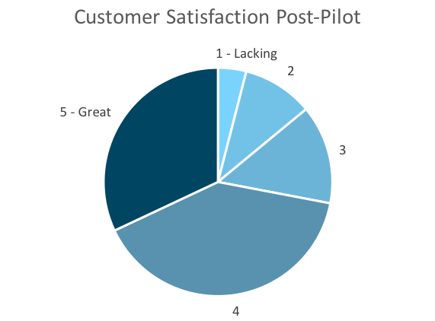
Customer Satisfaction: Pilot
Q. On a scale of 1-5, please rate your experience with the tablet overall.
This pie chart illustrates the results from the post-pilot survey.
72% of respondents indicated a customer satisfaction score of 4 or 5.
Notes:
First pie chart: Results from the post-pilot survey
Second pie chart: Results from the post-launch survey, after making changes
Satisfaction has gone up from 72% (4 and 5 rating) to 86% (4 and 5 rating)
Post-pilot data:
1 - Lacking 2 4%
2 5 10%
3 7 14%
4 20 40%
5 - Great 16 32%
Post-launch data:
1 - Lacking 1 2%
2 2 4%
3 4 8%
4 22 44%
5 - Great 21 42%

Slide 4
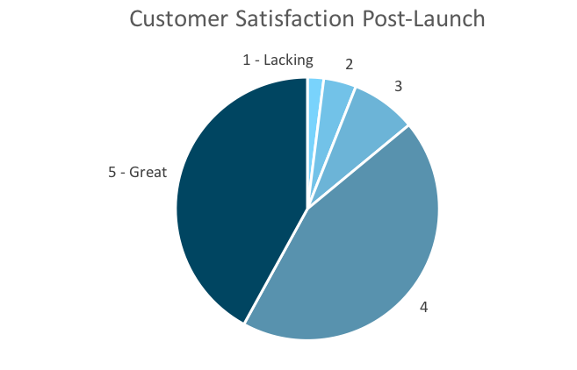
Customer Satisfaction: Launch
Q. On a scale of 1-5, please rate your experience with the tablet overall.
This pie chart illustrates the results from the post-launch survey.
86% of respondents indicated a customer satisfaction score of 4 or 5. This is a 14% increase.
Notes:
First pie chart: Results from the post-pilot survey
Second pie chart: Results from the post-launch survey, after making changes
Satisfaction has gone up from 72% (4 and 5 rating) to 86% (4 and 5 rating)
Post-pilot data:
1 - Lacking 2 4%
2 5 10%
3 7 14%
4 20 40%
5 - Great 16 32%
Post-launch data:
1 - Lacking 1 2%
2 2 4%
3 4 8%
4 22 44%
5 - Great 21 42%

Slide 5
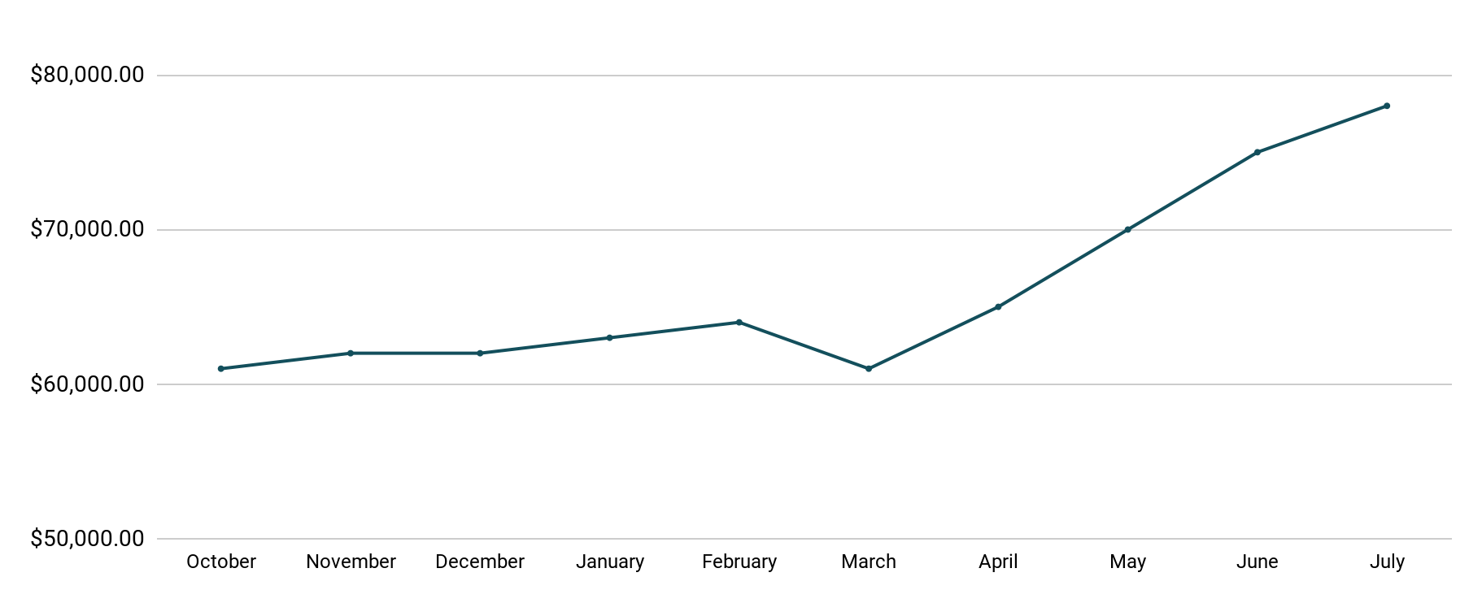
Revenue
Tablet Launch April 23
This is a chart of Sauce & Spoon revenue, showing that after tablet implementation, revenue increased.
July revenue was up to 20% over April’s monthly revenue.
Notes:
This is a chart of Sauce & Spoon revenue, showing that after tablet implementation, revenue increased. December revenue was up to 20% over September’s monthly revenue.
Sales data:
October
$61,000.00
November
$62,000.00
December
$62,000.00
January
$63,000.00
February
$64,000.00
March
$61,000.00
April
$65,000.00
May
$70,000.00
June
$75,000.00
July
$78,000.00

Slide 6
What Worked: Key Accomplishments
Decreased table turn time
Implementation of the tablets increased the average daily guest count by 10%.
Tablets also decreased wait time by 30 minutes.
Decreased food waste
Tablets identified who was receiving an incorrect order.
Kitchen staff has taken the initiative to correct orders and decrease food waste by 50%.
Increased customer satisfaction
After the pilot, customer satisfaction was at 72%.
Once we implemented improvements based on feedback, customer satisfaction increased to 86%.
Increased sales
Our monthly revenue has increased steadily since the tablet rollout, upwards of 20% since September/pre-rollout.
Tablets also helped boost revenue during the holiday season.

Slide 7
Next Steps: Looking Forward
Initiative | Action | Date
Implement tablets in more locations | Create new project plan for new location installation | Q2
Continue to track customer experience and satisfaction | Continue surveying/ gathering data through various means | Ongoing
Expand tablet features | Investigate new features like social media integration, reservations, videos, etc. | Q4

Slide 8
Appendix
Access all resources here.
Notes:
Insert link to your shared drive or a shared folder with all of the relevant project artifacts

